Slide 1
Azure, IoT, and Lambda Architecture
Josh Lane
@jplane

Slide 2

Josh Lane
Independent consultant
20+ years as developer, architect, instructor, amateur psychiatrist
Finance, insurance, education, telecom, energy
Microsoft Azure MVP
I don’t work for Microsoft ☺
@jplane
Twitter, GitHub, LinkedIn, GMail

Slide 3
Data Challenges in IoT
Throughput
Scale
Heterogenous schemas
Multiple devices and/or versions
Authentication
Storage
Events vs. messages vs. commands
Intent
Batching vs. streaming
Liveness vs. scope

Slide 4
Messages Events Commands
Message
Any discrete information exchanged between parties with a known or knowable schema
[purchase order, list of train schedules, etc.]
Event
A uniquely identified message whose intent is to describe something that has already happened
[PurchaseOrderCompletedEvent]
Command
A message whose intent is to describe something that should happen in the future
[StartTrainCommand]

Slide 5
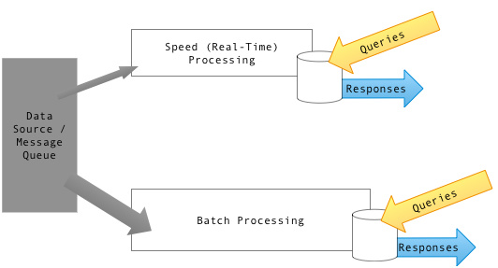
Lambda Architecture

Slide 6

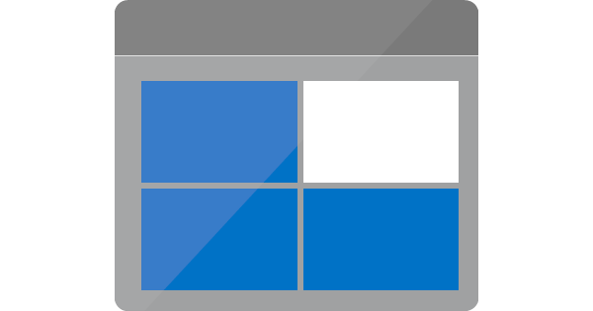

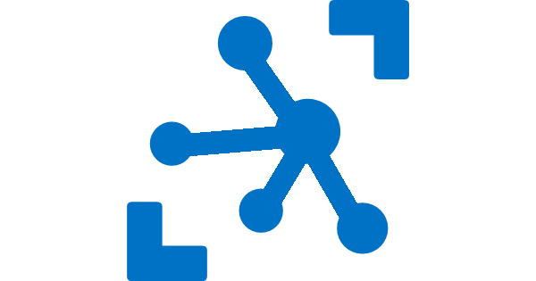



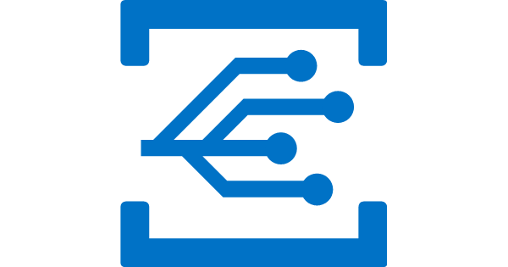

Slide 7
Guitar solo

Slide 8
Lambda Architecture

Slide 9
Lambda Architecture – Azure
Queries
Responses
Queries
Responses

Slide 10
Lambda Architecture – Azure
Message ingest
IoT Hub
Speed (“real-time”) processing
Stream Analytics + Cosmos DB
Batch processing
Data Lake
Serving layer
Power BI
Cheap long-term storage
Blob Storage
Event-driven processing
Event Grid

Slide 11
More info
https://github.com/jplane/aid-meetup
https://en.wikipedia.org/wiki/Lambda_architecture
https://azure.microsoft.com/en-us/services/iot-hub/
https://azure.microsoft.com/en-us/services/stream-analytics/
https://azure.microsoft.com/en-us/solutions/data-lake/
https://azure.microsoft.com/en-us/services/cosmos-db/
https://powerbi.microsoft.com/en-us/
https://azure.microsoft.com/en-us/services/event-grid/

Slide 12
Thank you!

